Slide 1

SRM AI Assistant – An Intelligent Academic Support System
KAARTHIK NARAIN
RA2432242010095
MCA GEN AI – B

Slide 2
Abstract
The SRM AI Assistant is a web-based intelligent chatbot built using Flask and Transformer-based AI models.
It helps students with academic queries like seat allocation, timetables, and updates.
The project integrates Retrieval-Augmented Generation (RAG) and semantic search for accurate responses.
Designed to simulate a real academic assistant for SRM students.

Slide 3
Problem Statement
Students face challenges in:
Quickly accessing academic details.
Finding seat allocations and timetables.
Getting real-time college updates.
There is no unified AI assistant that can handle all these academic tasks efficiently.

Slide 4
Objective
To build an AI-powered web assistant for SRM students.
To provide smart, context-aware responses to academic queries.
To integrate multiple modules like seat allocation, temperature fetching, and timetable automation.
To simplify communication between students and the academic system.

Slide 5
System Architecture
Frontend (UI): HTML, CSS, JS
Backend (Server): Flask Framework
AI Core:
Sentence Transformer for embeddings
FAISS for vector similarity search
HuggingFace Transformer for text generation
Database: CSV files for student and timetable records
APIs: Weather data, Gibberish detection

Slide 6
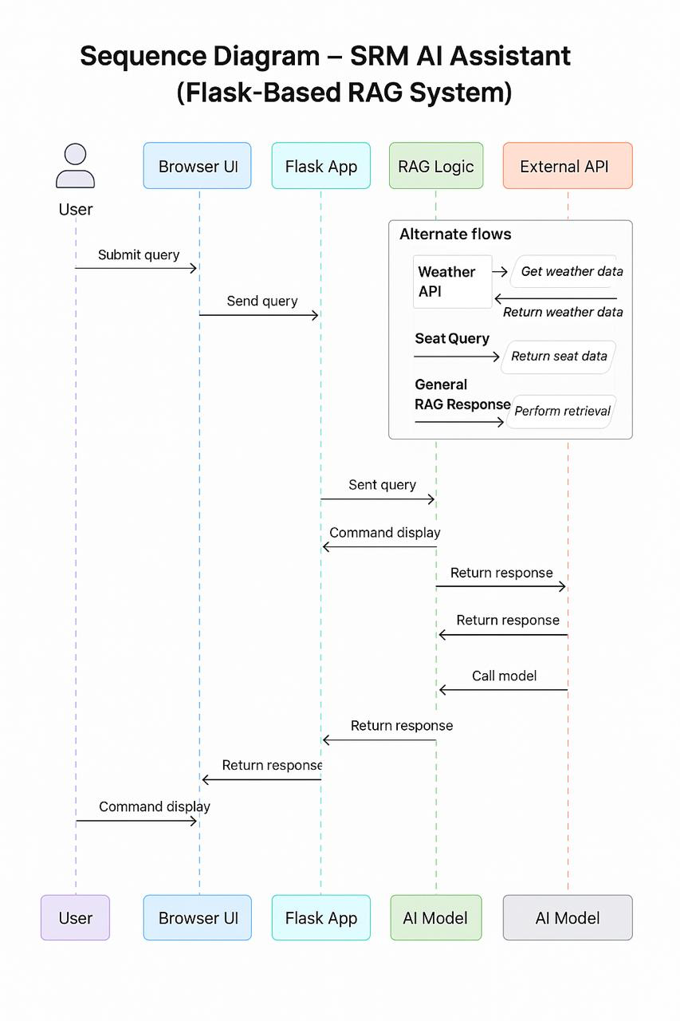
Workflow
User enters a query in the chatbot interface.
Input is preprocessed and checked for gibberish.
Embedding model converts the text into vector form.
FAISS searches for similar records in stored data.
Transformer model generates a natural language response.
The answer is displayed to the user.

Slide 7
Technologies used
Category | Tools / Frameworks
Programming Language | Python
Web Framework | Flask
NLP Libraries | Transformers, LangChain
Embedding Model | SentenceTransformer
Vector Database | FAISS
Data Handling | Pandas, NumPy
Frontend | HTML, CSS, JS
API Integration | Weather API

Slide 8
Features Implemented
🪑 Seat Allocation Search
🕒 Timetable Retrieval System
🌤️ Live Temperature Updates
🧹 Gibberish Detection for input cleanup
🔍 Semantic Search + RAG Integration for precise results
⚡ Fast Response Time with optimized model loading
💬 Chat-based AI Query System

Slide 9
Result and Performance
Achieved accurate and relevant responses for academic queries.
Reduced manual data lookup time by more than 80%.
Successfully integrates multiple data sources and AI models.
Deployed locally for testing and further enhancements.
User feedback: Interface is simple, interactive, and responsive.

Slide 10
Future enhancement
Add voice command and speech output.
01
Integrate with SRM ERP system for live student data.
02
Implement chat history and login system.
03
Deploy on Render / Hugging Face Spaces for 24×7 access.
04

Slide 11
Conclusion
The SRM AI Assistant demonstrates how Flask + NLP models can automate real-world academic support.
It’s a step toward AI-driven campus digitalization — smart, scalable, and student-friendly.

